Slide 1
Literature Review

Slide 2
Agender
Follow-up on the Previous Meeting
Summary of the Literature Review
Request for Advice on the Remaining Work

Slide 3
Follow up question:
AI is used too much?
  Use indirectly related papers only to support a broader idea, such as reducing gateway workload through cloud offloading.
    For a broad background statement: VLMs are increasingly becoming useful in many edge application scenarios, such as autonomous driving systems, intelligent monitoring, and real-time visual analysis.
    Reference: “Vision-language models for edge networks: A comprehensive survey”
  Use directly relevant papers to support the core concepts of my project, including distributed VLMs, trusted execution environments (TEEs) .
  Implementation:
    Compare the generated text from local inference using the same nanoVLM model with that produced by the cloud-side split-inference service.
  What is the next?
    Implementation? Experiment design?
    More literature review?
Notes:
When I screen papers, I usually start with the abstract and introduction to assess their relevance to my research topic. If a paper is not related to my core research question, I do not read the full paper in detail. In addition I check the conclusion to see whether the authors identify any limitations, open problems, or research gaps that may be relevant to my project.
I want to be honest that I hope to achieve a strong result in this capstone. Some family matters and my own communication issues affected my progress earlier. I take responsibility for that, and I am trying to improve how I plan and communicate.
Could you please advise me whether there are still areas where I can make meaningful improvements? I would especially like to know what I should prioritise most to strengthen the final project.

Slide 4
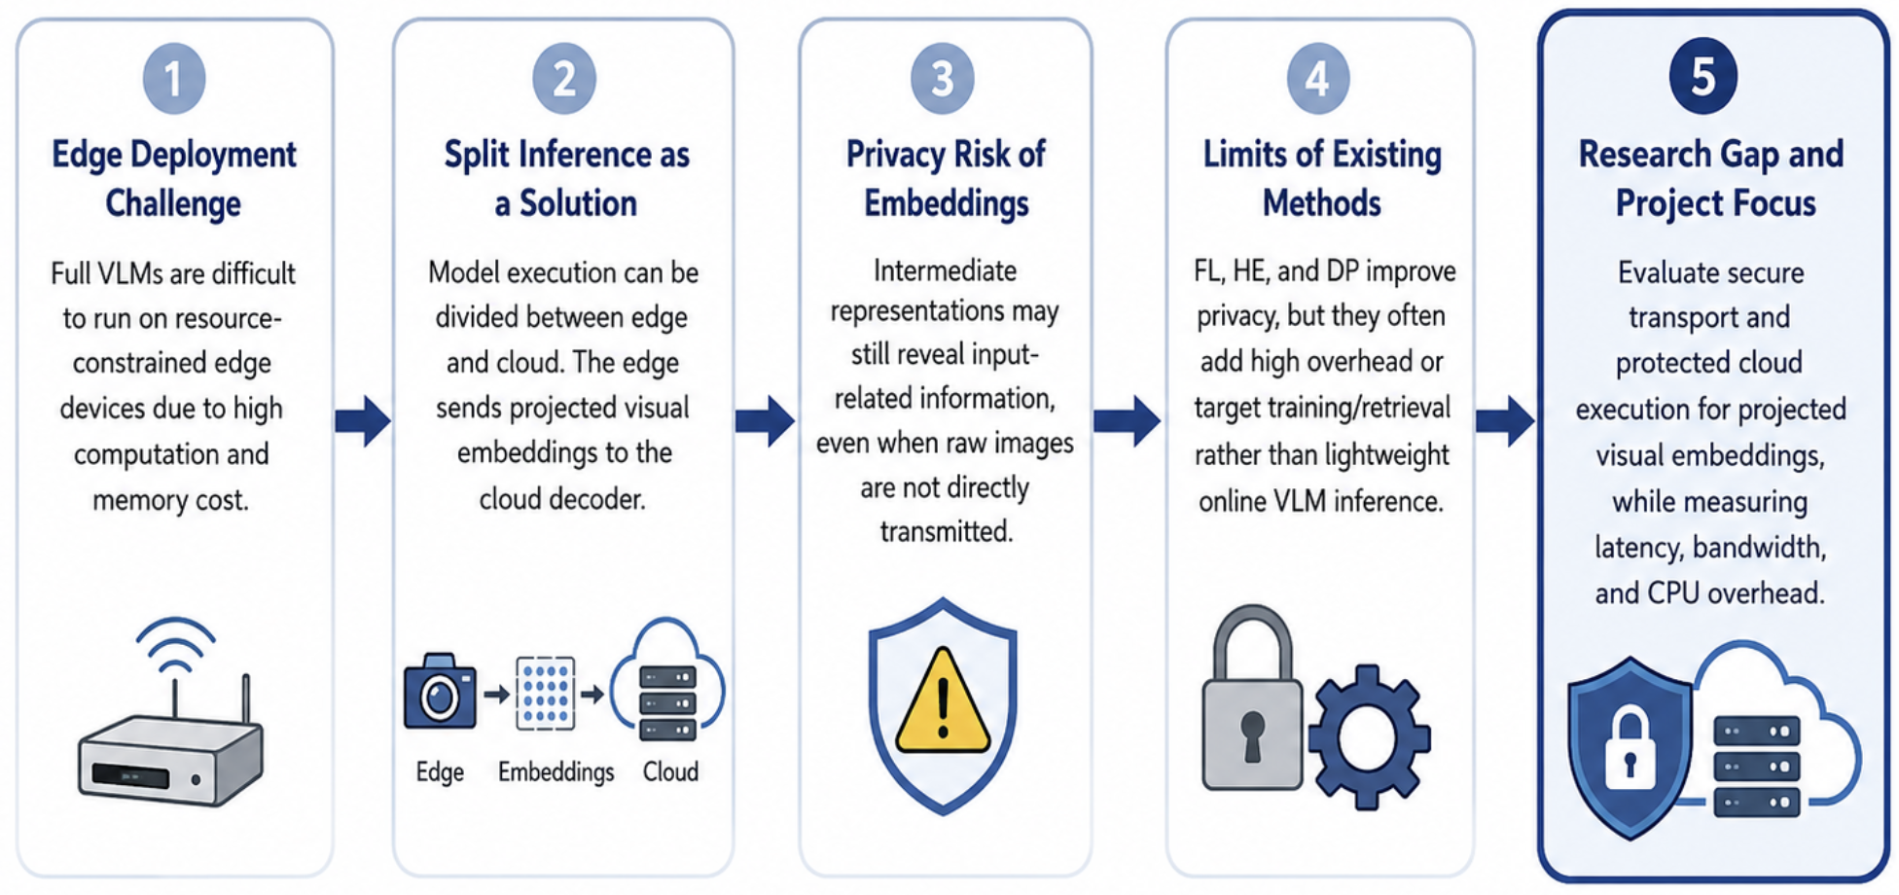
Literature Review Logic and Research Gap
The key gap is how to protect intermediate embedding in split VLM inference.
Notes:
This slide explains the logic of the literature review and the research gap of this project.
First, full vision-language models are difficult to deploy on resource-constrained edge devices. They require high computational power and memory, which are often not available on devices such as mobile or IoT platforms.
However, intermediate embeddings are not inherently private, as sensitive visual information may still be reconstructed or inferred from them.
A reconstruction attack may recover an approximate version of the original image from an intercepted embedding. Under a white-box threat model, an attacker who knows the client-side model and has gained a large number of image–embedding pairs can train an inversion model to reconstruct visually similar images.

Slide 5
Threat Model
Trusted and untrusted components
Trusted:
  Edge device and its local VLM visual encoder/projector
  Cryptographic implementation
  Trusted execution environment used for cloud-side decoding
Potentially untrusted:
  Public network between edge and cloud
  Cloud operating system, hypervisor, and infrastructure administrator
  External attacker able to observe or interfere with network traffic
  LLM decoder is trusted only when it runs inside the confidential-computing environment.
Main attacker
An active network attacker
  eavesdrop on embedding packets (Confidentiality)
  modify, drop, delay, replay, or inject packets; (Integrity)
  attempt a man-in-the-middle attack; (Confidentiality, Integrity)
  impersonate the edge or cloud endpoint if authentication is absent.
A privileged cloud-side attacker
  compromised host OS tries to read process memory.
  Process debugging or injection
  Logging leakage
  Storage leakage
Out of scope:
Hardware vulnerabilities, TEE side-channel attacks, physical attacks, denial-of-service attacks
Compromise of the edge device
Notes:
“out of scope,” I mean issues that are outside the boundary of this project. I acknowledge that they exist, but I will not design, implement, or evaluate defences against them in this capstone.

Slide 6
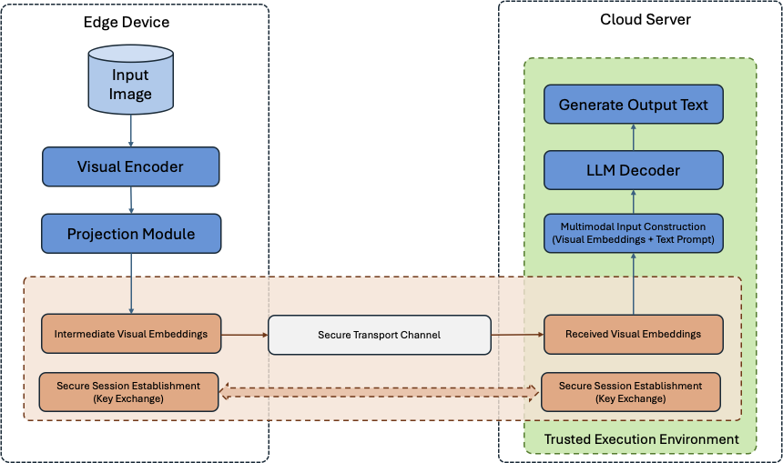
METHODOLOGY
The design is informed by distributed VLM architectures, secure edge-cloud communication, and confidential computing.
The edge device processes the input image using the visual encoder and projection module.
The resulting intermediate visual embeddings are serialised and securely transmitted to the cloud.
The cloud combines the received embeddings with the processed text prompt to form the multimodal input. The LLM decoder generates the final text output inside a trusted environment.
Notes:
ECCDH?
Certificate

Slide 7
Related work - 1
Theme | Representative Papers | Main Findings and Limitations | Relate to topic
Edge Deployment of Vision–Language Models | VLM edge deployment survey MobileVLM EdgeVL | Lightweight architectures, efficient projectors, knowledge distillation, and quantisation can reduce the computational and memory demands of VLMs on resource-constrained devices. However, distillation and quantisation-aware training add training and engineering complexity, while model compression may reduce capability on complex vision–language tasks. Consequently, fully deploying capable VLMs on highly constrained edge devices remains challenging. | Motivates splitting the VLM pipeline between edge and cloud, while high lighting the need to protect data generated at the split point.
Notes:
At the beginning, I looked into the deployment challenges of VLMs, especially their resource requirements, to understand why split inference may be needed.
One possible solution to the VLM deployment problem is to use lightweight VLMs. Therefore, I continued my literature review by examining papers on MobileVLM and EdgeVL.
MobileVLM: LDP, smaller LLM,

Slide 8
Related work - 2
Theme | Representative Papers | Main Findings and Limitations | Relate to topic
Split Inference and Dis- tributed VLM Architec- tures | Neurosurgeon; distributed VLM architecture | Split inference partitions model execution between edge and cloud resources. Recent distributed VLM work sends projected visual embeddings from an edge-side visual encoder and projection module to a cloud-side language decoder. The split point affects communication cost, local computation, cloud computation, and end-to-end latency. | Provides the technical basis for the implemented pipeline, in which projected visual embeddings are generated at the edge and reconstructed for cloud-side VLM decoding.

Slide 9
Related work - 3
Theme | Representative Papers | Main Findings and Limitations | Relate to topic
Privacy Risks of Intermediate Representations | UnSplit; Feature-Oriented Reconstruction Attack (Both assume an honest-but-curious) | Intermediate representations (smashed data) can reveal information about client inputs under particular split-learning threat models. Honest-but-curious servers may use received representations and knowledge of the client-side model to reconstruct inputrelated information. | Supports the security motivation of the project: projected visual embed- dings should not automatically be treated as non-sensitive data, even when raw images are not directly transmitted.
Privacy-Preserving and Secure Inference Methods (signal Methods) | Federated Learning FedAGRU; client selection; Homomorphic Encryption: ENCRYPTION-FRIENDLY LLM ARCHITECTURE Differential Privacy; | FL mainly protects training data by keeping it on local clients, while HE enables encrypted computation at substantial computational cost. DP provides formal privacy guarantees through controlled noise addition, which may reduce utility. | Directly informs the proposed system, which evaluates protected embedding transmission and hardware-backed protection for cloud-side processing.
Notes:
If transport encryption is compromised, an attacker may obtain the intermediate embeddings. To perform feature inversion, the attacker usually needs knowledge of the encoder, access to the encoder, or sufficient auxiliary data to train a substitute model.
On the other hand, an attacker can use embedding–image pairs to learn an approximate inverse mapping from embeddings to input images. To generate a large number of such pairs independently, the attacker needs knowledge of the encoder or access to an embedding-generation service.
Federated learning is designed for collaborative model training rather than split inference. It keeps raw training data on local clients, but it does not address the protection of intermediate embeddings while they are processed in the cloud.
HE enables encrypted computation at substantial computational cost.

Slide 10
Related work - 4
Theme | Representative Papers | Main Findings and Limitations | Relate to topic
Privacy-Preserving and Secure Inference Methods (Combined Methods) | Privacy-preserving multimodal retrieval: PMIRS | Combined multimodal designs can use FL， feature obfuscation and encryption method, but may focus on retrieval or training rather than online VLM inference. Main idea: federated learning is used to train or fine-tune a shared global model, while split learning divides the model between edge devices and the cloud during inference. | Supports the security motivation of the project: projected visual embeddings should not automatically be treated as non-sensitive data, even when raw images are not directly transmitted.
Secure Transport and Protected Cloud Execution | ChaCha20-Poly1305; confidential computing: SecMdp, DarkneTZ | Authenticated encryption can protect embedding confidentiality and integrity during network transmission. Trusted execution environments can isolate selected data and model components during execution. However, protected execution introduces deployment, compatibility, and runtime-overhead considerations | Directly informs the proposed system, which evaluates protected embedding transmission and hardware-backed protection for cloud-side processing.

Slide 11
Initial Ideas
Protocol: QUIC TLS 1.3 (UDP, reduce latency, Encryption Algorithm, Key exchange)
TLS 1.3: enable mutual certificate authentication (mTLS)
DataSet: HuggingFaceM4 /the_cauldron AI2D subset
Model: nanoVLM
Forward secrecy: Enabled through ephemeral ECDHE.
Encryption: ChaChao20-Poly1305 vs AES-GCM
TEE: Intel TDX

Slide 12
MobileVLM
MobileVLM is an efficiency-oriented VLM. Its goal is to make a vision-language model run locally on mobile/edge hardware by reducing the language-model size and, especially, reducing the number of visual tokens sent into the LLM.
Main pipeline:
Image -> CLIP ViT-L/14 visual encoder (576 visual tokens)
LDP: Lightweight Downsample Projector (144 visual tokens)
-> MobileLLaMA (1.4B or 2.7B) -> Generated text answer
key contribution: LDP (Lightweight Downsample Projector)

Slide 13
Authentication
Secure_and_Lightweight_User_Authentication_Scheme_for_Cloud-Assisted_Internet_of_Things.pdf
  This paper proposes an authentication scheme for large-scale cloud-assisted IoT systems. It uses the cloud service to verify users and store user-related authentication data, reducing the computation and storage burden on the gateway.
  Embedded_Systems_Authentication_and_Encryption_Using_Strong_PUF_Modeling
    This paper proposes an challenge-response authentication. Authenticating client by comparing response return from client with generated response from PUF model.
  The limitation: The output of PUF is unstable. It is impractical for large-scale use.
Notes:
Regarding authentication, I reviewed two papers.

Slide 14
EdgeVL
MobileVLM is an efficiency-oriented VLM. Its goal is to make a vision-language model run locally on mobile/edge hardware by reducing the language-model size and, especially, reducing the number of visual tokens sent into the LLM.
Main pipeline:
Image -> CLIP ViT-L/14 visual encoder (576 visual tokens)
LDP: Lightweight Downsample Projector (144 visual tokens)
-> MobileLLaMA (1.4B or 2.7B) -> Generated text answer
key contribution: LDP (Lightweight Downsample Projector)

Slide 15
A privacy-preserving multi-user retrieval system for multimodal artificial intelligence - 1
What problem?
  Main Framework: distributed edge nodes + cloud-based AI applications.
  Edge-side: User image / text -> Encoder -> Embedding
  Cloud–side: Cloud retrieval / matching -> Return relevant image/text result
  Context: Raw image, text, or embedding may contain private information.
  Used for: medical image retrieval, privacy-conscious customer service bots.
What method (Main Idea)?
  Present PMIRS, a system Combinates obfuscation techniques (block-wise projection), encrypted inference (AES + CBC 128-bit keys), secure key management (Diffie-Hellman) + federated learning.
  In the training phase, using Federated learning for Privacy-Preserving Training, which improves the F1-score and precision of the model without user-sensitive data. In the inference phase, combining obfuscation techniques, encrypted techniques (AES + CBC) and DH for secure key management.

Slide 16
A privacy-preserving multi-user retrieval system for multimodal artificial intelligence - 2
Threat Model: The threat model assumes that the cloud server is not fully trusted.
Framework Design:
Component Selection:
  A lightweight model based on the CLIP codebase. (Pre-trained model and fine-tuned)
  Encryption Algorithm : AES-CBC 128 bits,
  Fine-tuning method: Federated Learning (Upload weights with AES Encryption)
Evaluation:
  Simulated cloud-based LLM environment
  F1-score
Data Set:
  ImageNet

Slide 17
A privacy-preserving multi-user retrieval system for multimodal artificial intelligence - 3
Limitations:
  Although PMIRS presents a layered privacy-preserving design, its security architecture is not optimal.
  First, the use of AES-CBC with 128-bit keys only provides confidentiality and does not offer built-in integrity protection. Without an authentication tag or MAC, encrypted embeddings may still be vulnerable to tampering or ciphertext manipulation. A modern authenticated encryption scheme such as AES-GCM or ChaCha20-Poly1305 would be more appropriate, especially for latency-sensitive edge or mobile environments.
  Second, Diffie–Hellman is mainly a key agreement protocol rather than a complete authentication mechanism. If DH is performed for every session, it may introduce unnecessary computational and communication overhead, and without signatures or certificates, it may also be vulnerable to man-in-the-middle attacks.
  Third, although federated learning reduces raw data exposure by keeping user data local, the system does not provide clear defenses against malicious clients.

Slide 18
Semantic Edge–Cloud Communication for Real-Time Urban Traffic Surveillance With ViT and LLMs Over Mobile Networks
The Literature illustrates the proposed edge-cloud semantic communication pipeline, where YOLOv11 first extracts vehicle-centric area at the edge, ViT converts these area into compact embeddings for mobile network transmission, and the cloud reconstructs the images and uses LLaVA to generate traffic surveillance responses.
-- Not Useful for my research topic.

Slide 19
Vision-Language Models for Edge Networks: A Comprehensive Survey
Summary: Privacy-preserving and secure edge AI techniques
Federated Learning: Keeps data localized on edge devices and only shares model weights instead of raw data.
Differential Privacy: Adds controlled noise to model updates or outputs to reduce the risk of reconstructing sensitive information.
Secure Aggregation: Ensures that the server can only access aggregated model updates, not individual client updates.
Homomorphic Encryption: Enables computation to be performed directly on encrypted data without decrypting it.
Secure Multiparty Computation: Allows multiple parties to jointly compute a result without revealing their private inputs to one another.

Slide 20
ENCRYPTION-FRIENDLY LLM ARCHITECTURE
HE is applied to both the fine-tuning phase and the inference phase.
Gaussian Kernel attention is used instead of Softmax attention to reduce computational cost under HE.
LoRA fine-tuning is used to reduce large ciphertext-ciphertext matrix multiplications.
The architecture makes private fine-tuning and encrypted inference more practical.

Slide 21
Research Question
How can intermediate embeddings be protected in transit and in use in edge-cloud split inference?
Literature Review: Key Findings:
a single privacy-preserving technique may not provide practical, end-to-end protection across all relevant stages of the data lifecycle in an edge-cloud split-inference architecture.
Recent studies have proposed system-level designs (e.g. PMIRS, SplitML) that combine multiple privacy and security mechanisms. However, the integration and performance trade-offs of protecting intermediate embeddings in both transit and use remain insufficiently evaluated for edge-cloud split VLM inference.
Notes:
After the literature review, I extended the topic, which not only focuses on data in transit but also on data in use.
After the literature review, I extended the project scope. The original focus was mainly on protecting intermediate embeddings during transmission between the edge device and the cloud server. However, secure transport alone does not protect the embeddings after they arrive at the cloud for decoding.
My core idea is not to develop a new encryption algorithm. Instead, I want to design and evaluate a practical system architecture. The literature suggests that individual techniques usually protect only one part of the data lifecycle. Therefore, I want to combine mutual authentication, secure transmission, and confidential cloud-side processing to protect intermediate embeddings both in transit and in use.
Existing privacy-preserving techniques address different parts of the problem. Secure transport protects embeddings while they are transmitted. Confidential-computing mechanisms aim to protect data while it is processed. Federated learning mainly addresses privacy in collaborative training rather than split inference. Other techniques, such as homomorphic encryption and differential privacy, may introduce practical limitations in performance, functionality, or security coverage.
A single technique may not provide practical end-to-end protection across all relevant stages of the data lifecycle.

